Slide 2
All-Your-GPUs-Are-Belong-To-Us: An inside look at NVIDIA’s Self-Healing GeForce NOW Infrastructure
Ryan Hallisey and Piotr Prokop NVIDIA

Slide 3

GeForce Now
Large Fleet of Kubernetes Clusters (40+ Clusters, 30,000+ Nodes)
Lots of KubeVirt workloads running on GPUs (60,000+ GPUs)

Slide 4


Maintaining the Fleet

Slide 5
Maintaining the Fleet
How do we maintain this infrastructure?
Insert Next-generation GPUs
Kubernetes Upgrade
GPU Driver Upgrade
OS Upgrade
Vbios Upgrade
Remediation
Ect…

Slide 6
Goals and Non-Goals
Goals
Upgrade infrastructure without impacting users
Scalable solution
Support any current and future infrastructure upgrade
Automation maintenance operations
Non-Goals
Reimplement or replace $ kubectl drain
Create an NVIDIA only solution

Slide 7
Maintenance API
Create a Maintenance API to track the state of a Maintenance
Define states that every maintenance must go through
State Requirements
Schedule a Drain
Start a Drain
Complete a Drain
Start a Maintenance
Complete a Maintenance or Fail a Maintenance
Start Validating the Maintenance
Complete Validation or Fail Validation
Return to Production

Slide 8
NotifyMaintenance API
Schedule a Drain = MaintenanceScheduled
Start a Drain = MaintenanceStarted
Complete a Drain …
Start a Maintenance
Complete a Maintenance or Fail a Maintenance
Start Validating the Maintenance
Complete Validation or Fail Validation
Return to Production = MaintenanceComplete

Slide 9
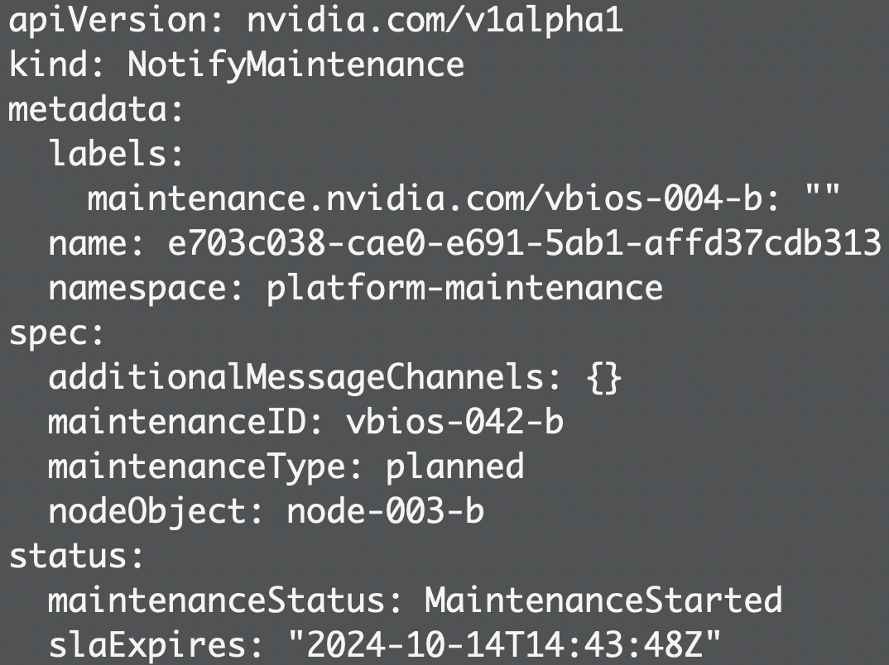
NotifyMaintenance API

Slide 10
Maintenance API
NotifyMaintenance API
Requirement | NotifyMaintenance State
Schedule a Drain | MaintenanceScheduled
Start a Drain | MaintenanceStarted
Complete a Drain | ObjectsDrained
Start Maintenance | ObjectsDrained
Complete Maintenance or Fail Maintenance | Validating or MaintenanceIncomplete
Start Validating the Maintenance | Validating
Complete Validation or Fail Validation | MaintenanceEnded or MaintenanceIncomplete
Return to Production | MaintenanceComplete
Notes:
Show a Notify Maintenance object?

Slide 11

NotifyMaintenance API
Coordinating Maintenance between Operators. This should include Humans too!
State transition “events” in Kubernetes are sent to SNS
Format messages for human consumption

Slide 12
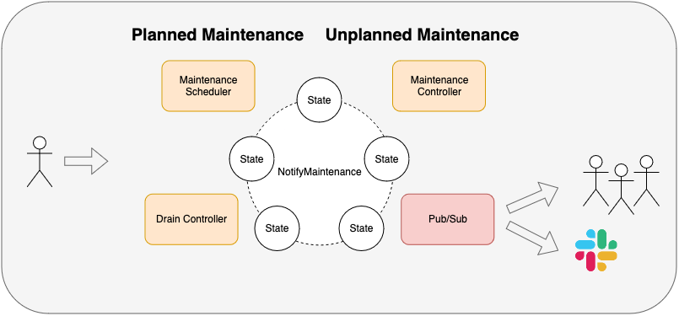
Maintenance Inside a Single Cluster

Slide 13
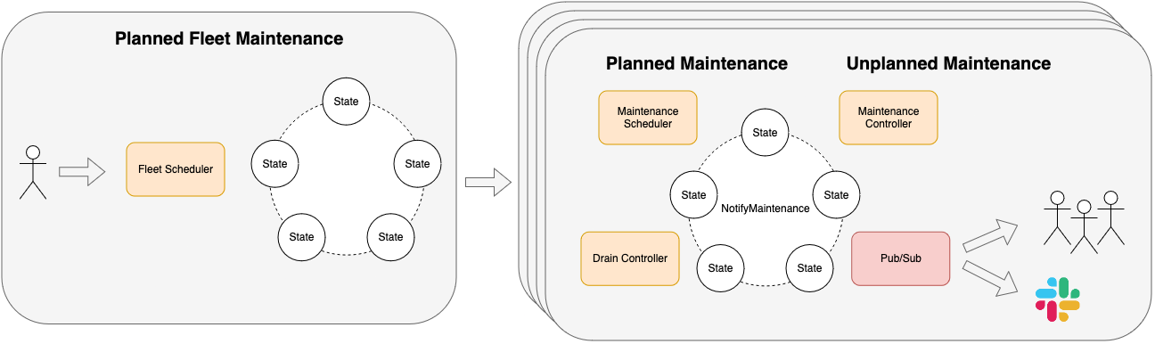
Coordinating Fleet Maintenance
Notes:
Unplanned maintenance is our real world example
We want Nodes to automatically heal without developer getting paged. So we want to remove the human from the picture.
We have used the NotifyMaintenance API with other community projects like the Node Problem Detector to do unplanned maintenance.

Slide 14
Unplanned maintenance
Hardware failures (GPU falling off the bus)
Software crashes(which can be a symptom of bad hardware too)
The more GPUs you have the probability of failure increases
We just need to accept failures and incorporate remediations as part of our ongoing operations

Slide 15
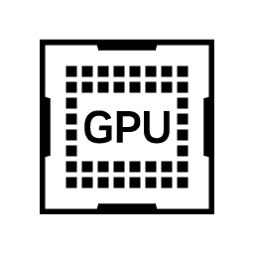

Unplanned maintenance - past
K8s Node
K8s Node
K8s Node
K8s Node
Notes:
In the past we were having happily working cluster

Slide 16
Unplanned maintenance - past
K8s Node
K8s Node
K8s Node
K8s Node
Notes:
One GPU on a node is bad ( we observe it via alerts like capacity goes down) and we need to manually recover the node

Slide 17
Unplanned maintenance - past
Diagnose
K8s Node
K8s Node
K8s Node
K8s Node
Notes:
Someone has to ssh into the node, diagnose it. We have to share the knowledge between the team about common failure signatures etc

Slide 18
Unplanned maintenance - past
Diagnose
Remediate
K8s Node
K8s Node
K8s Node
K8s Node
Notes:
Some nodes stayed broken for a long time and we didn’t even notice it which were lowering our capacity

Slide 19
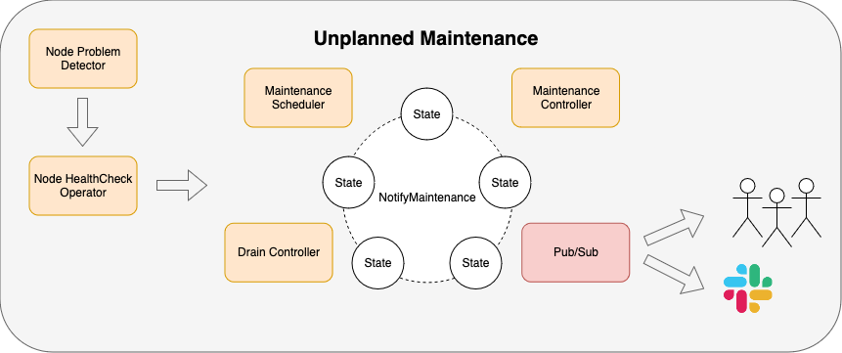
Unplanned maintenance - present
Notes:
We want to remove human from the picture so our engineers can spend their time on basically anything else than manually diagnosing and fixing node.

Slide 20
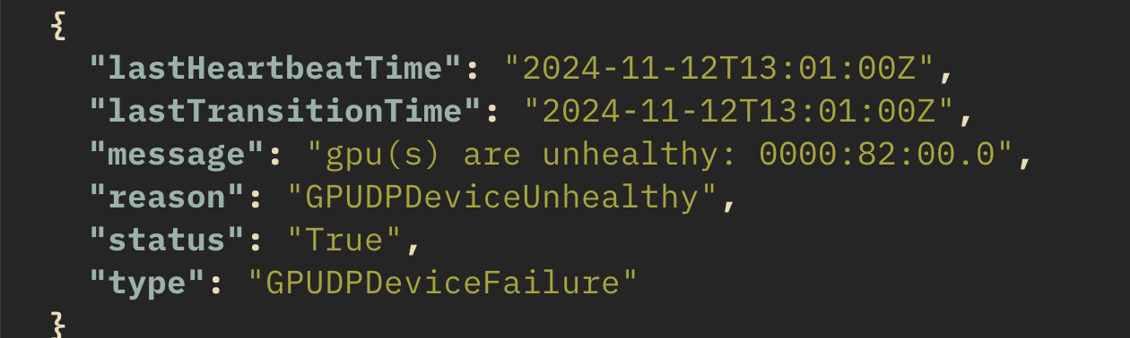
Unplanned maintenance - detection
Current approach:
Kubernetes NodeConditions as API
Notes:
NodeConditions are not the best API for reporting hardware issues as it lucks fields to specify which GPU failed so we post it as message field.
As usual we start with existing Kubernetes APIs to build something and when we see that this API not enough we need to add something new :) Maybe DRA can help us solve it?

Slide 21

Unplanned maintenance - detection
We use couple of detection daemones:
Node problem detector
Custom gpu problem detector as part of our GPU device plugin
Notes:
NodeConditions are not the best API for reporting hardware issues as it lucks fields to specify which GPU failed so we post it as message field

Slide 22

Unplanned maintenance - remediation
We use Node Healthcheck Operator to trigger remediation
Remediations are executed by our remediation engine
Failing remediations are being escalated until consider unfixable

Slide 23
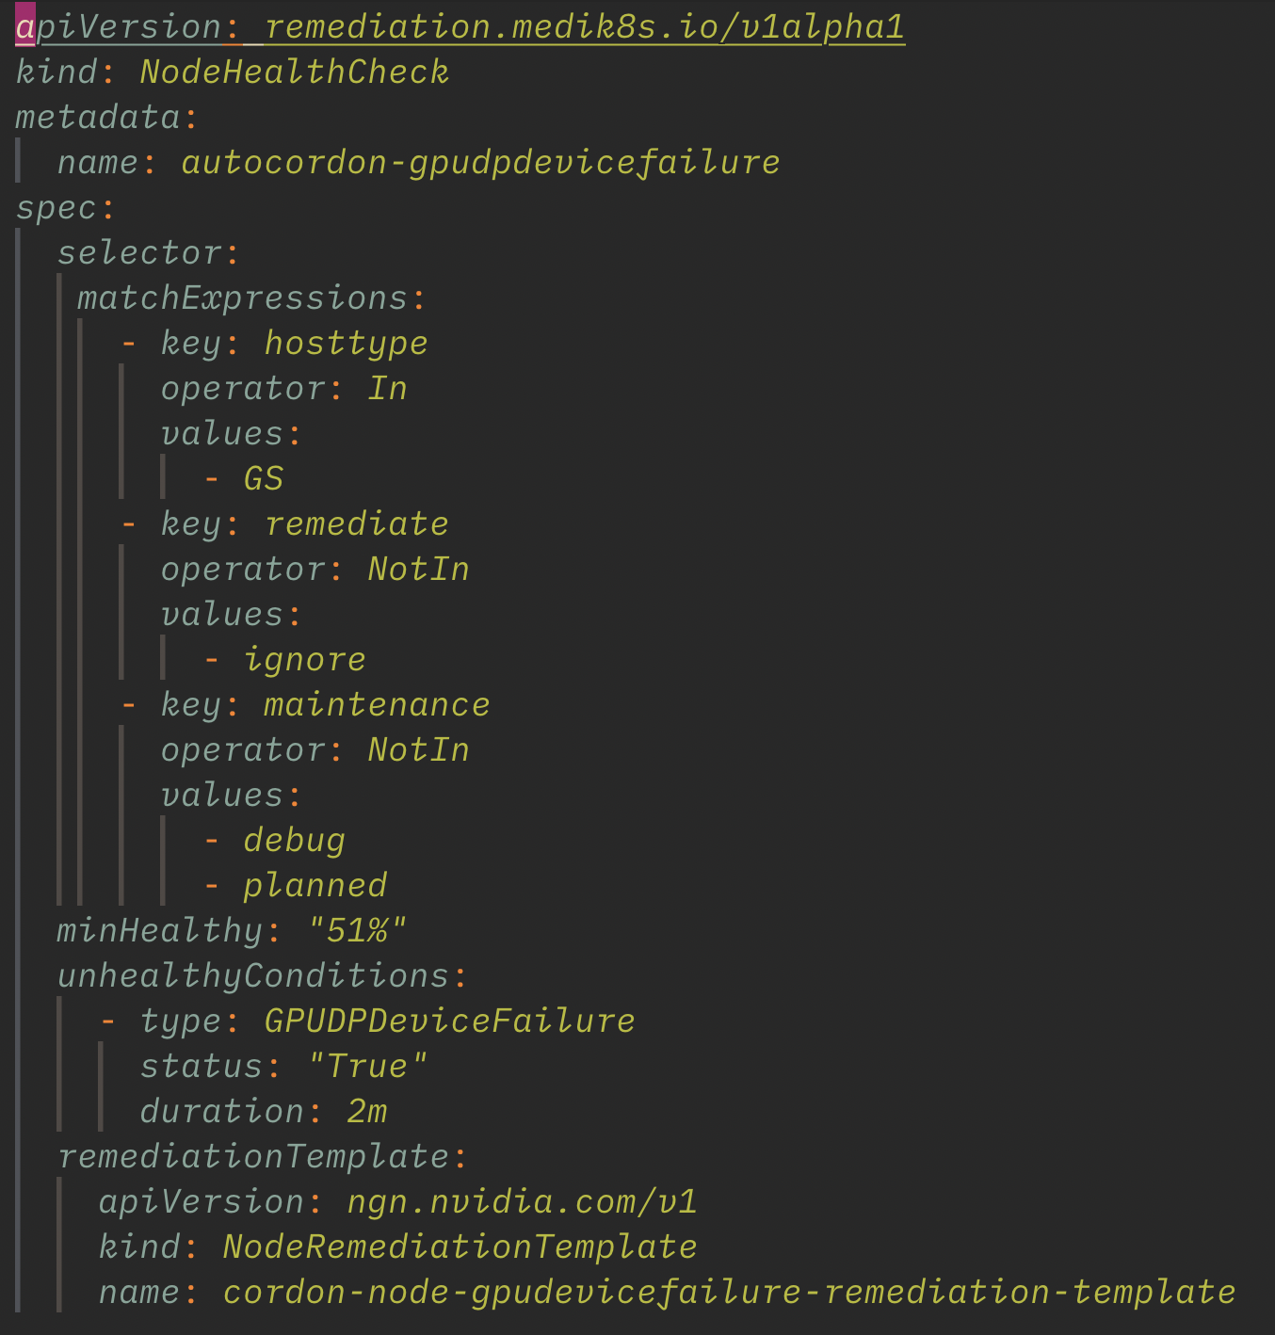
Unplanned maintenance - remediation

Slide 24
Unplanned maintenance - remediation engine
Perform remediation
Perform escalated remediation
Server went AWOL
Perform specified remediation, for a GPU driver issue or GPU fell off the bus it can be as simple as the host reboots.
When previous remediation failed for example host is stuck on reboot.Trigger escalated remediation for example IPMI power cycle.
Machine is not responsive we need to manually triage what’s wrong with it. This can mean some hardware issue.

Slide 25

Unplanned maintenance - validation
It’s always recommended not only to write tests but also execute them :)
Run simple sanity check and mark node as validated so it can get back to work

Slide 26
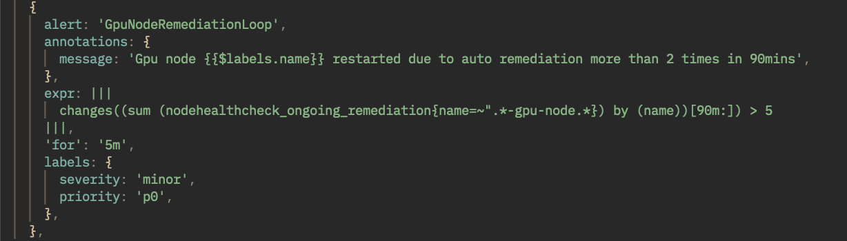
Unplanned maintenance - gotchas
Before setting up metrics for our remediation engine, we often had a situation where we were fixing same host over and over again
Now we have alerts to detect remediation loops

Slide 27
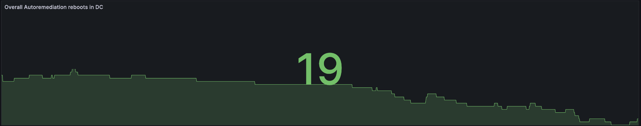
Unplanned maintenance - summary
~19 remediations per day/1000 nodes on average
Developers are not being paged anymore

Slide 28

NotifyMaintenance is Open Source
https://github.com/NVIDIA/pika
Start a Working Group?
Node Maintenance Issue and KEP https://github.com/kubernetes/enhancements/issues/4212

Slide 29

Thank You - Feedback

Slide 30

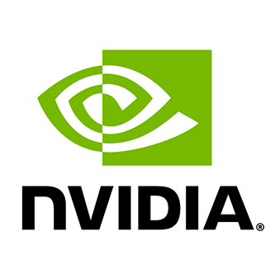
NVIDIA & Community Talks
ArgoCon: Building a Cutting-Edge Kubernetes Internal Developer Platform at NVIDIA | Tuesday 10:40am - 11:05am
Lightning Talk: Evaluating Scheduler Efficiency for AI/ML Jobs Using Custom Resource Metrics | Tuesday 5:45pm - 5:50pm
Lightning Talk: Running Kind Clusters with GPU Support Using Nvkind | Tuesday 6:05pm - 6:10pm
Keynote: NVIDIA Case Study: The Many Facets of Building + Delivering AI in the Cloud Native Ecosystem | Wednesday 10:05am-10:20am
All-Your-GPUs-Are-Belong-to-Us: An Inside Look at NVIDIA's Self-Healing GeForce NOW Infrastructure | Wednesday 11:15am - 11:50am
Maintainer Track: Kubernetes WG Device Management - Advancing K8s Support for GPUs | Wednesday 2:30pm - 3:05pm
AIStore as a Fast Tier Storage Solution: Enhancing Petascale Deep Learning Across Cloud Backends | Wednesday 2:30pm - 3:05pm
A Tale of 2 Drivers: GPU Configuration on the Fly Using DRA | Wednesday 3:25pm - 4:00pm
Tutorial: Get the Most Out of Your GPUs on Kubernetes with the GPU Operator | Wednesday 4:30pm - 6:00pm
From Silicon to Service: Ensuring Confidentiality in Serverless GPU Cloud Functions | Thursday 11:00am - 11:35am
Unlocking Potential of Large Models in Production | Thursday 2:30pm - 3:05pm
Which GPU Sharing Strategy Is Right for You? a Comprehensive Benchmark Study Using DRA | Thursday 4:30pm - 5:05pm
Engaging the KServe Community, The Impact of Integrating a Solutions with Standardized CNCF Projects | Thursday 5:25pm - 6:00pm
Maintainer Track: WG Serving: Accelerating AI/ML Inference Workloads on Kubernetes | Friday 11:55am - 12:30pm
From Vectors to Pods: Integrating AI with Cloud Native | Friday 2:00pm - 2:35pm
Enabling Fault Tolerance for GPU Accelerated AI Workloads in Kubernetes | Friday 2:55pm - 3:30pm
Thousands of Gamers, One Kubernetes Network | Friday 2:55pm - 3:30pm
Best Practices for Deploying LLM Inference, RAG and Fine Tuning Pipelines on K8s | Friday 4:00pm - 4:35pm
Best of Both Worlds: Integrating Slurm with Kubernetes in a Kubernetes Native Way | Friday 4:55pm - 5:30pm

